Slide 1

Computer Organization And Architecture
CSE-209
Lecture – 07
Al Bashir
Lecturer, Dept. of CSE
Dhaka International University

Slide 2
Content
Computer Memory System Overview
Cache Memory Principles
Elements of Cache Design

Slide 3
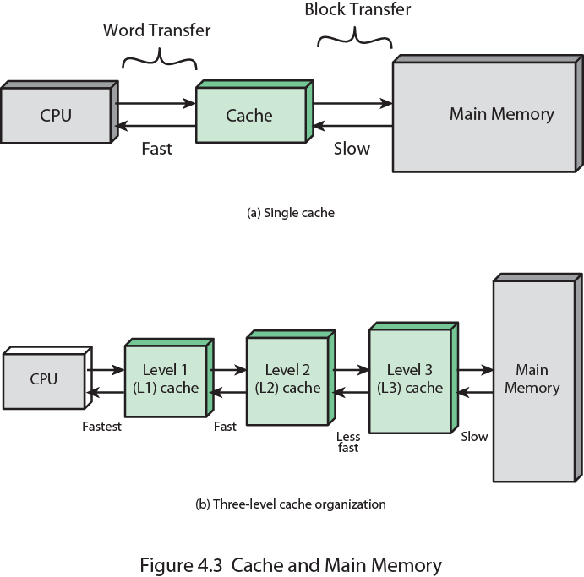
Cache and Main Memory

Slide 4
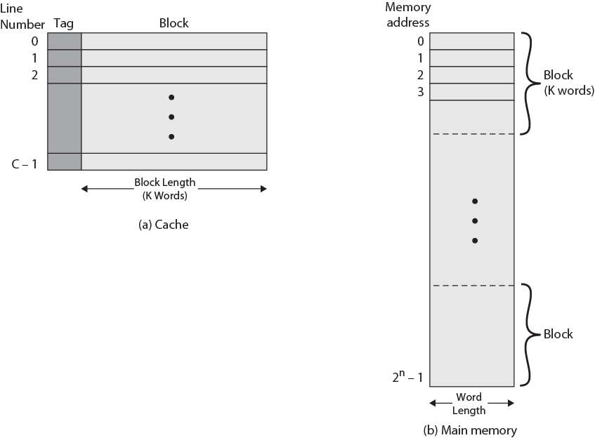
Cache/Main Memory Structure

Slide 5
Cache/Main Memory Structure
Main memory consists of up to 2^{n} addressable words, with each word having a unique n-bit address.
For mapping purposes, this memory is considered to consist of a number of fixed length blocks of K words each. That is, there are M=2^{n}/K blocks in main memory.
The cache consists of m blocks, called lines[1]. Each line contains K words, plus a tag of a few bits.
[1]In referring to the basic unit of the cache, the term line is used, rather than the term block, for two reasons:
to avoid confusion with a main memory block, which contains the same number of data words as a cache line; and
(2) because a cache line includes not only K words of data, just as a main memory block, but also include tag and control bits.

Slide 6
Cache Read Operation
The processor generates the read address (RA) of a word to be read.
If the word is contained in the cache, it is delivered to the processor.
Otherwise, the block containing that word is loaded into the cache, and the word is delivered to the processor.

Slide 7
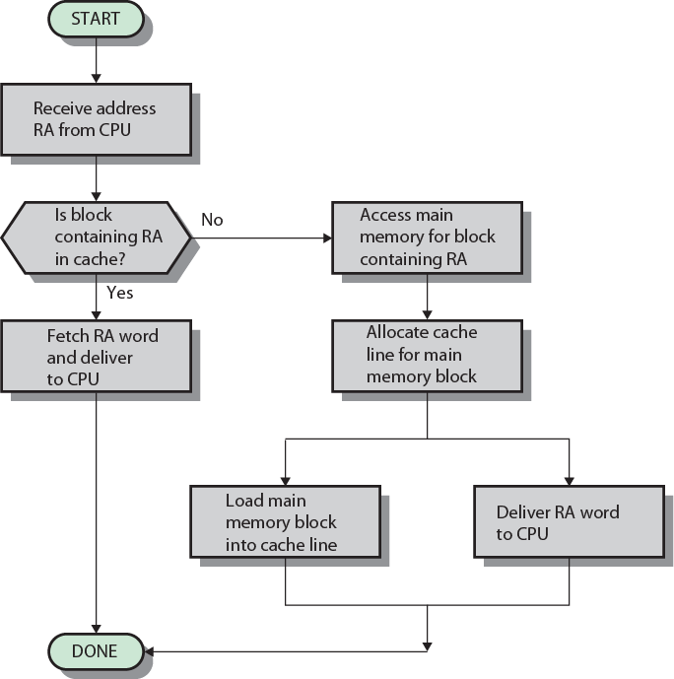
Cache Read Operation - Flowchart

Slide 8
Cache Organizations
The cache connects to the processor via data, control, and address lines.
The data and address lines also attach to data and address buffers, which attach to a system bus from which main memory is reached.
When a cache hit occurs, the data and address buffers are disabled and communication is only between processor and cache, with no system bus traffic.
When a cache miss occurs, the desired address is loaded onto the system bus and the data are returned through the data buffer to both the cache and the processor.

Slide 9
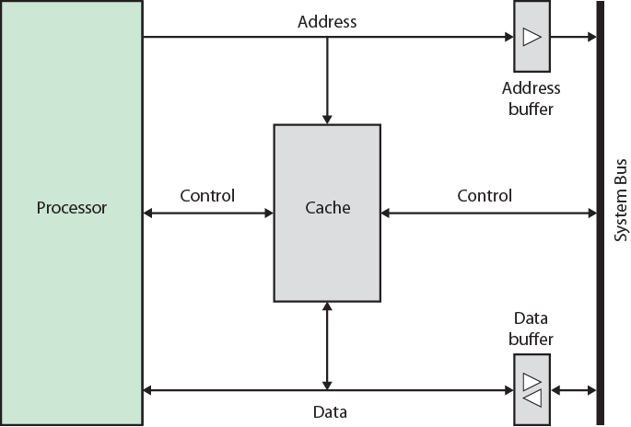
Cache Organizations
.

Slide 10
Mapping Function
Because there are fewer cache lines than main memory blocks, an algorithm is needed for mapping main memory blocks into cache lines.
Further, a means is needed for determining which main memory block currently occupies a cache line.
Three techniques can be used:
Direct
Associative and
Set associative

Slide 11
Direct Mapping
The simplest technique, known as direct mapping, maps each block of main memory into only one possible cache line.
The mapping is expressed as-
i = j modulo m
where
i = cache line number
j = main memory block number
m = number of lines in the cache

Slide 12
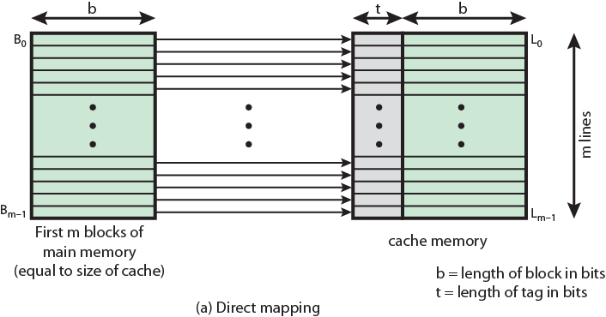
Direct Mapping
Figure shows the mapping for the first m blocks of main memory. Each block of main memory maps into one unique line of the cache.

Slide 13
Direct Mapping : Cache Line Table
The next m blocks of main memory map into the cache in the same fashion; that is, block B_{m} of main memory maps into line L₀ of cache, block B_{m1} maps into line L₁, and so on.
i = j modulo m
Cache line | Main Memory blocks held
0 | 0, m, 2m, 3m…2^{s}-m
1 | 1,m+1, 2m+1…2^{s}-m+1
…
m-1 | m-1, 2m-1,3m-1…2^{s}-1

Slide 14
Direct Mapping
Simple
Inexpensive
Fixed location for given block
If a program accesses 2 blocks that map to the same line repeatedly, cache misses are very high

Slide 15
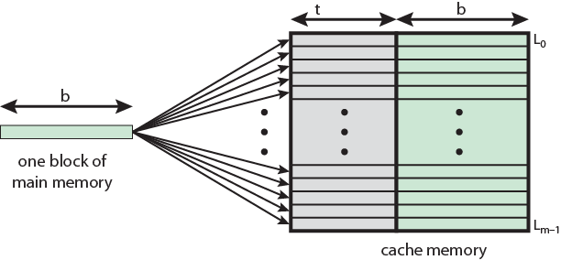
Associative Mapping
A main memory block can load into any line of cache.
Memory address is interpreted as tag and word.
Tag uniquely identifies block of memory.
Every line’s tag is examined for a match.
Cache searching gets expensive.

Slide 16
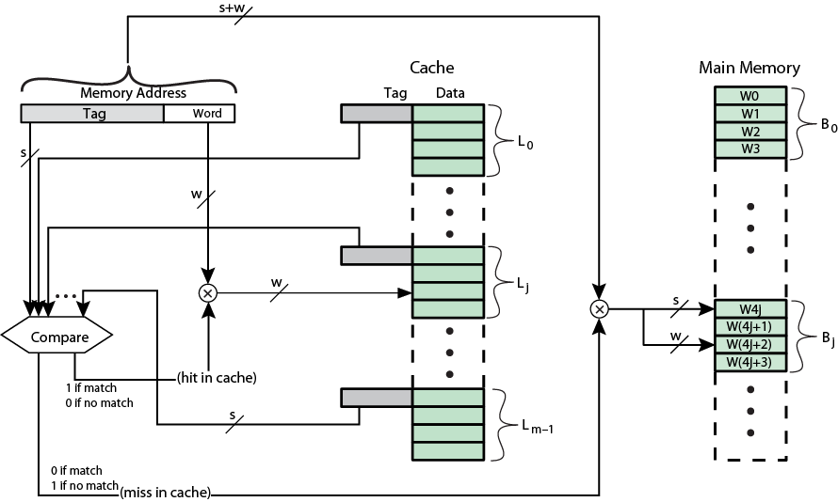
Associative Mapping

Slide 17
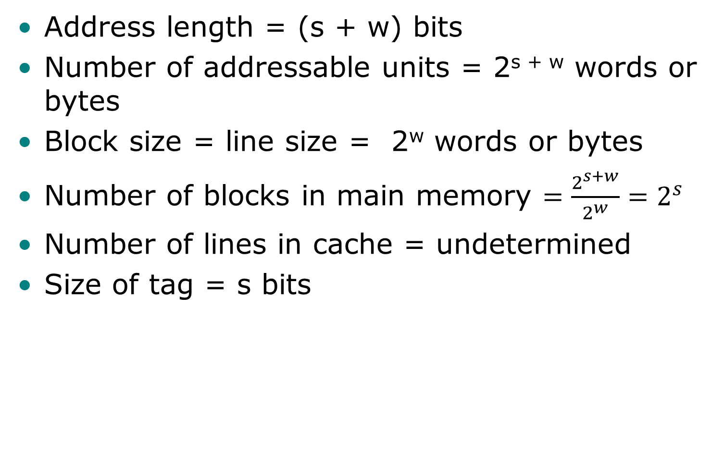
Associative Mapping
Address length = (s + w) bits
Number of addressable units = 2^{s + w} words or bytes
Block size = line size = 2^{w} words or bytes
Number of blocks in main memory $=\frac{2^{s+w}}{2^{w}}=2^{s}$
Number of lines in cache = undetermined
Size of tag = s bits

Slide 18
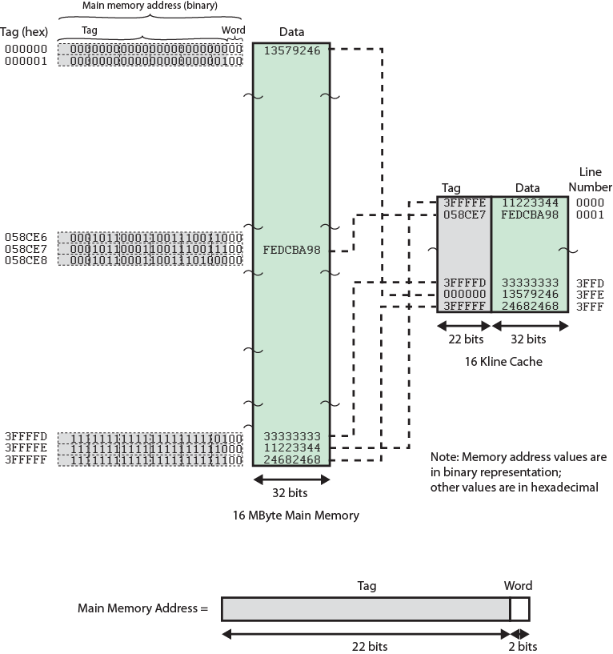
Associative Mapping

Slide 19
Associative Mapping : Example
Previous figure shows our example using associative mapping.
A main memory address consists of a 22-bit tag and a 2-bit byte number.
The 22-bit tag must be stored with the 32-bit block of data for each line in the cache. Note that it is the leftmost (most significant) 22 bits of the address that form the tag.
Thus, the 24-bit hexadecimal address 16339C has the 22-bit tag 058CE7.

Slide 20
Associative Mapping : Example
This is easily seen in binary notation:
MA: 0001 0110 0011 0011 1001 1100 (binary)
1 6 3 3 9 C (hex)
tag 00 0101 1000 1100 1110 0111 (binary)
0 5 8 C E 7 (hex)
(leftmost 22 bits)

Slide 21
Question??

Slide 22
Thanks

